Slide 1





Optimally managing threats to biodiversity across large scales
Jeffrey O. Hanson, Dobrochna M. Delsen, Allison Binley, James Allan, Martin Jung, Piero Visconti, Virgilio Hermoso, Richard Schuster, Melissa Chapman, Joseph R. Bennett
jeffrey.hanson@uqconnect.edu.au
jeffrey-hanson.com

Slide 2

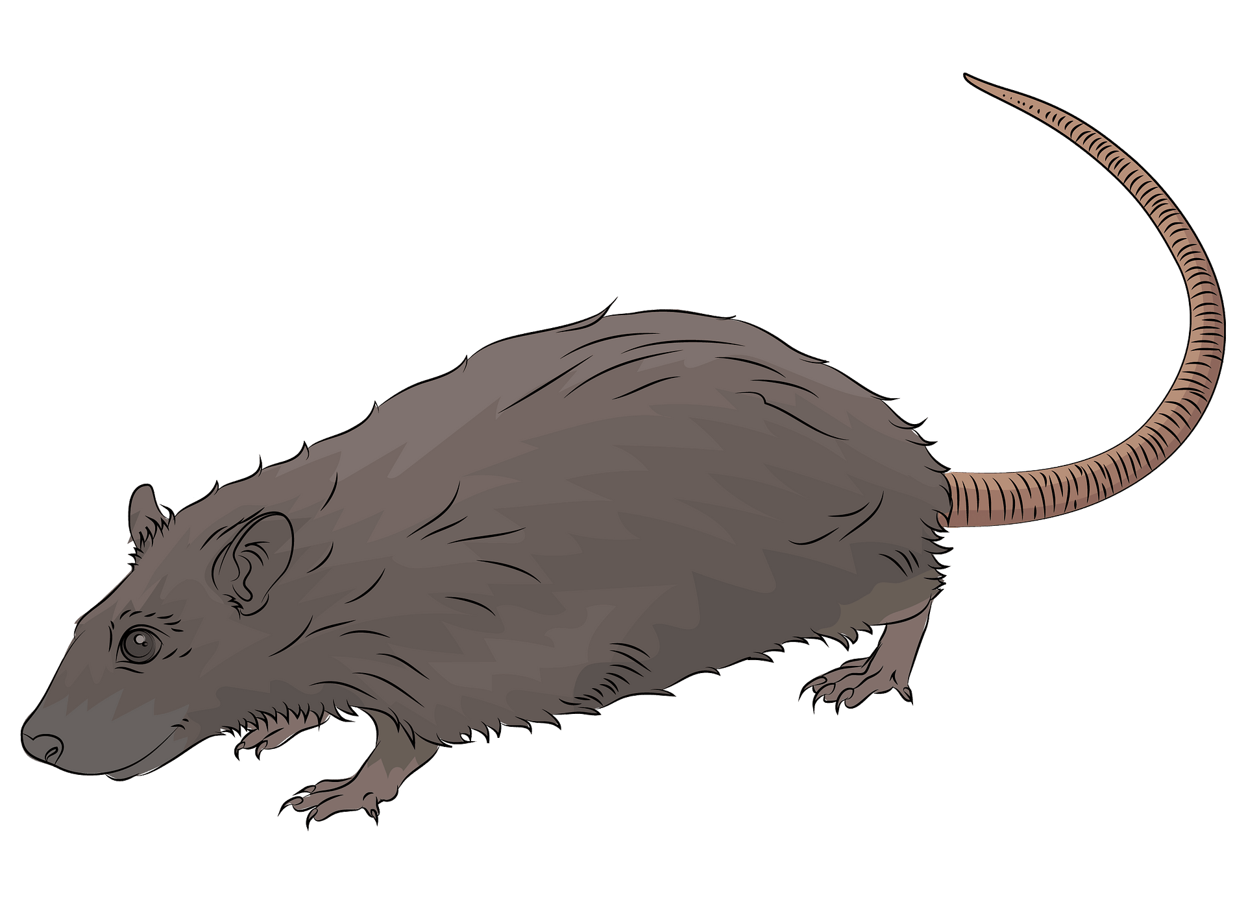
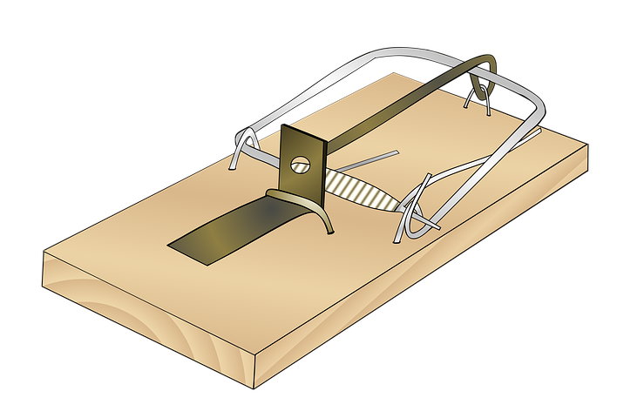
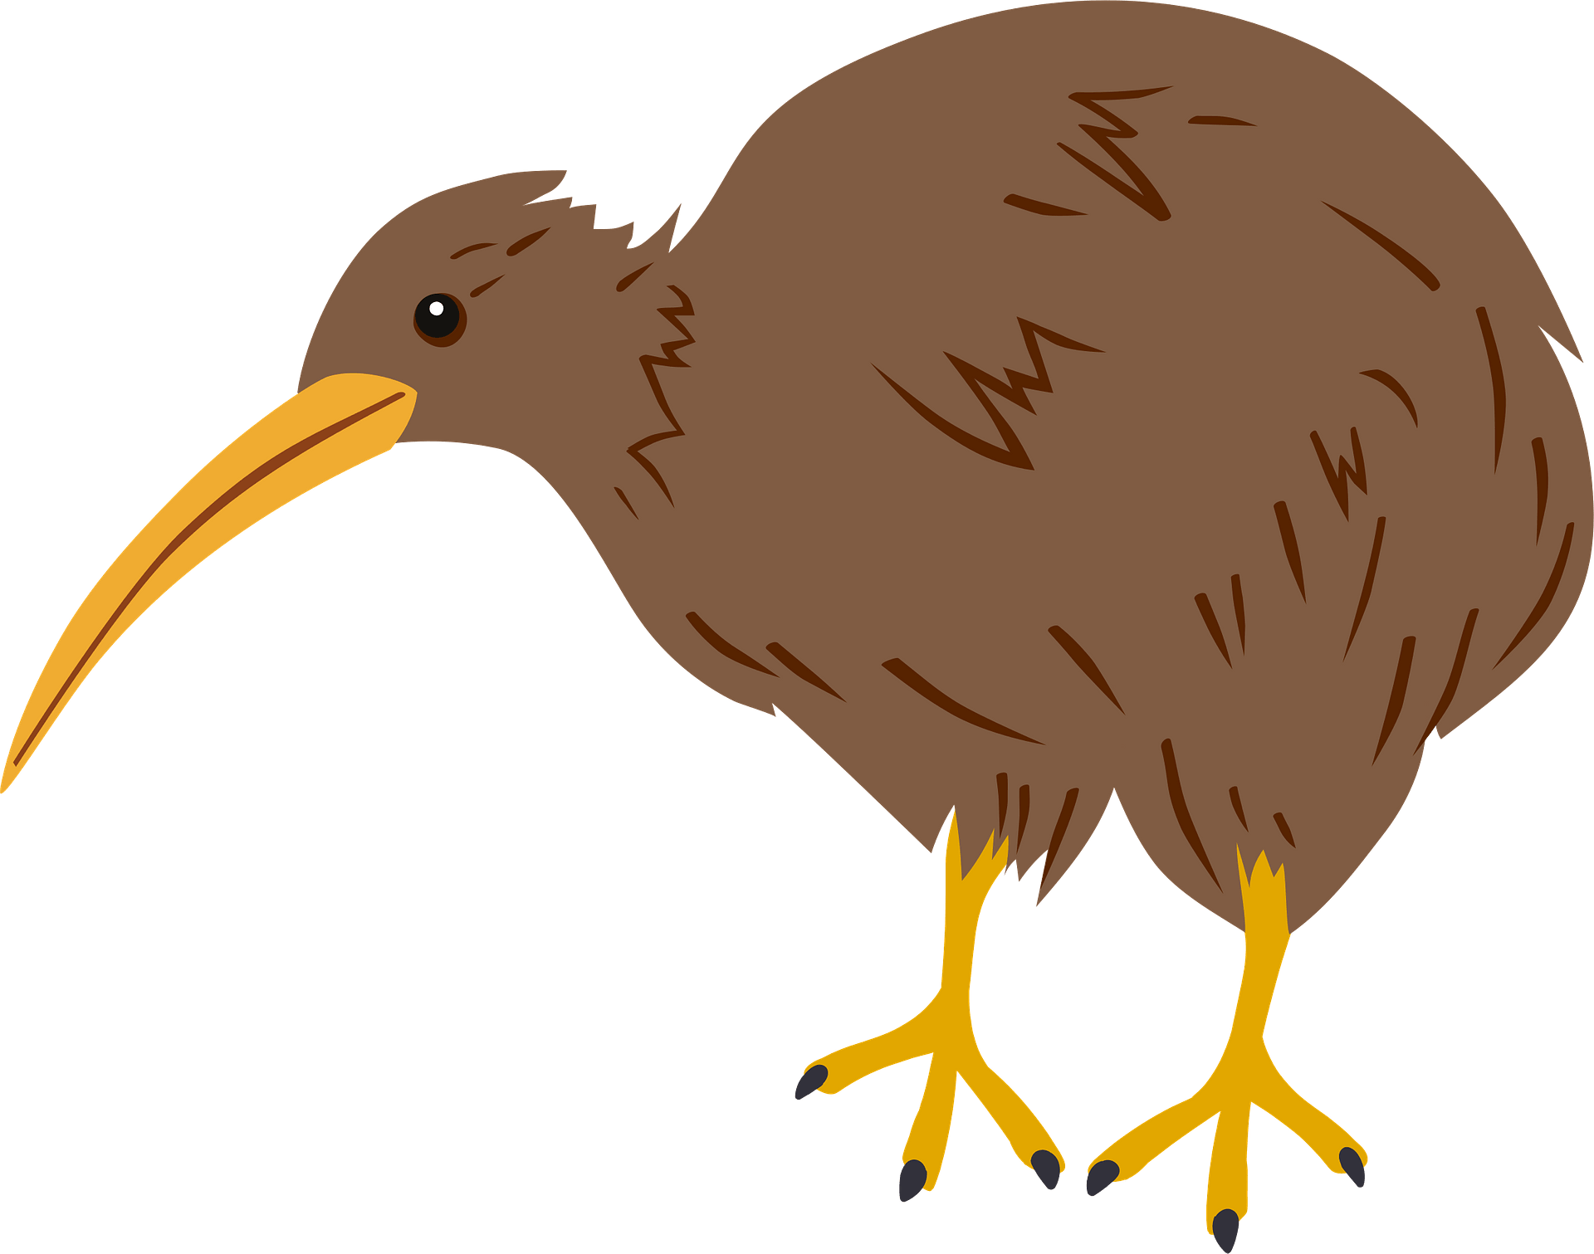
Conservation is actions in places
1. Area impacted by threat
2. Implement action to abate threat
3. Positive conservation outcome

Slide 3
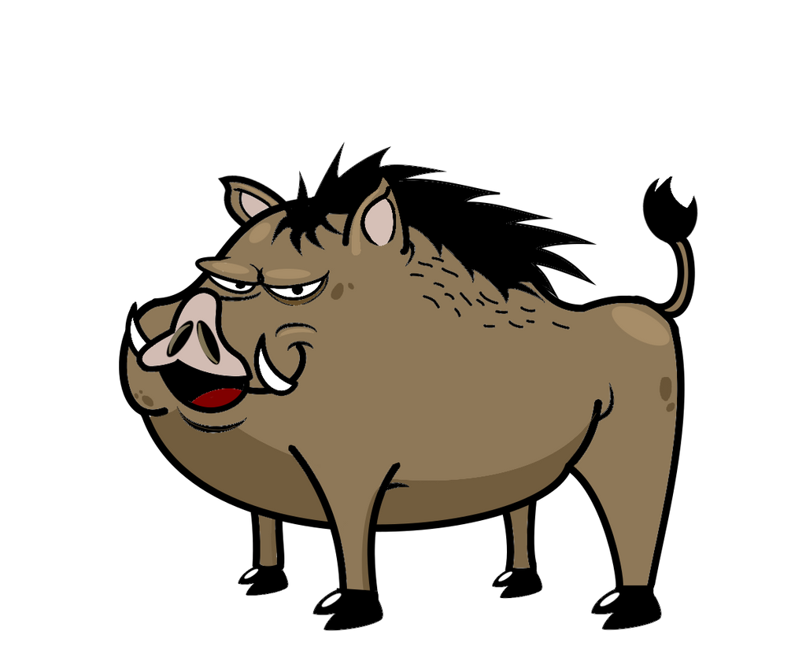

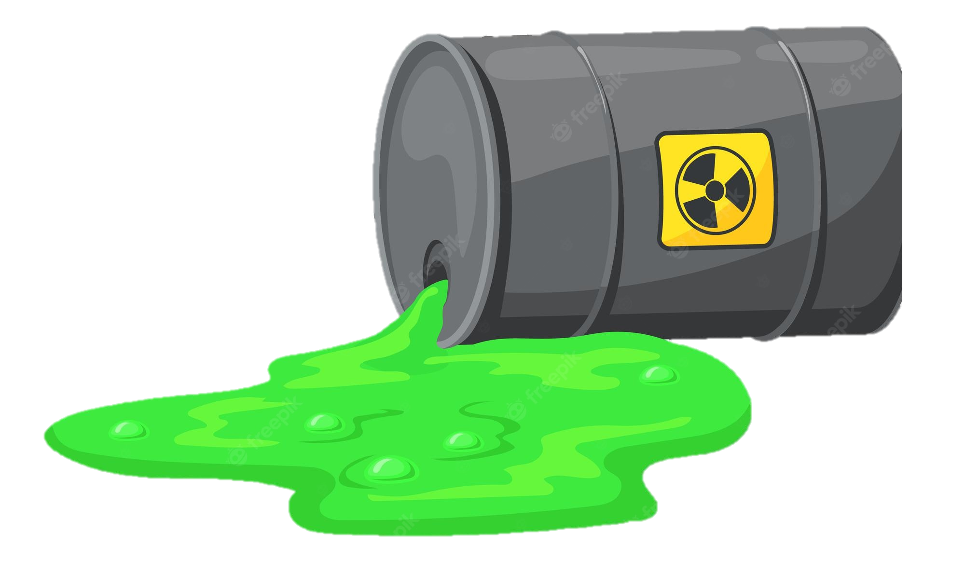
Which threats to abate?

Slide 4




Which threats to abate?

Slide 5
Which threats to abate?
$1M
$4M
$2M
$5M

Slide 6

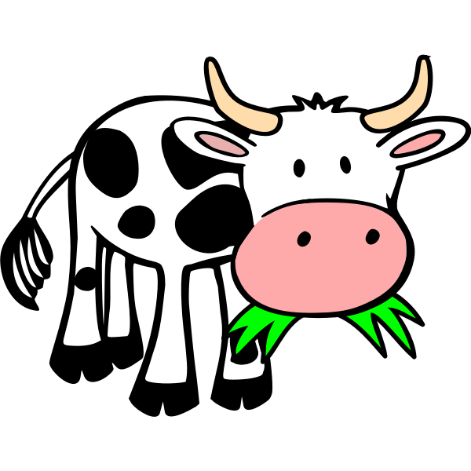

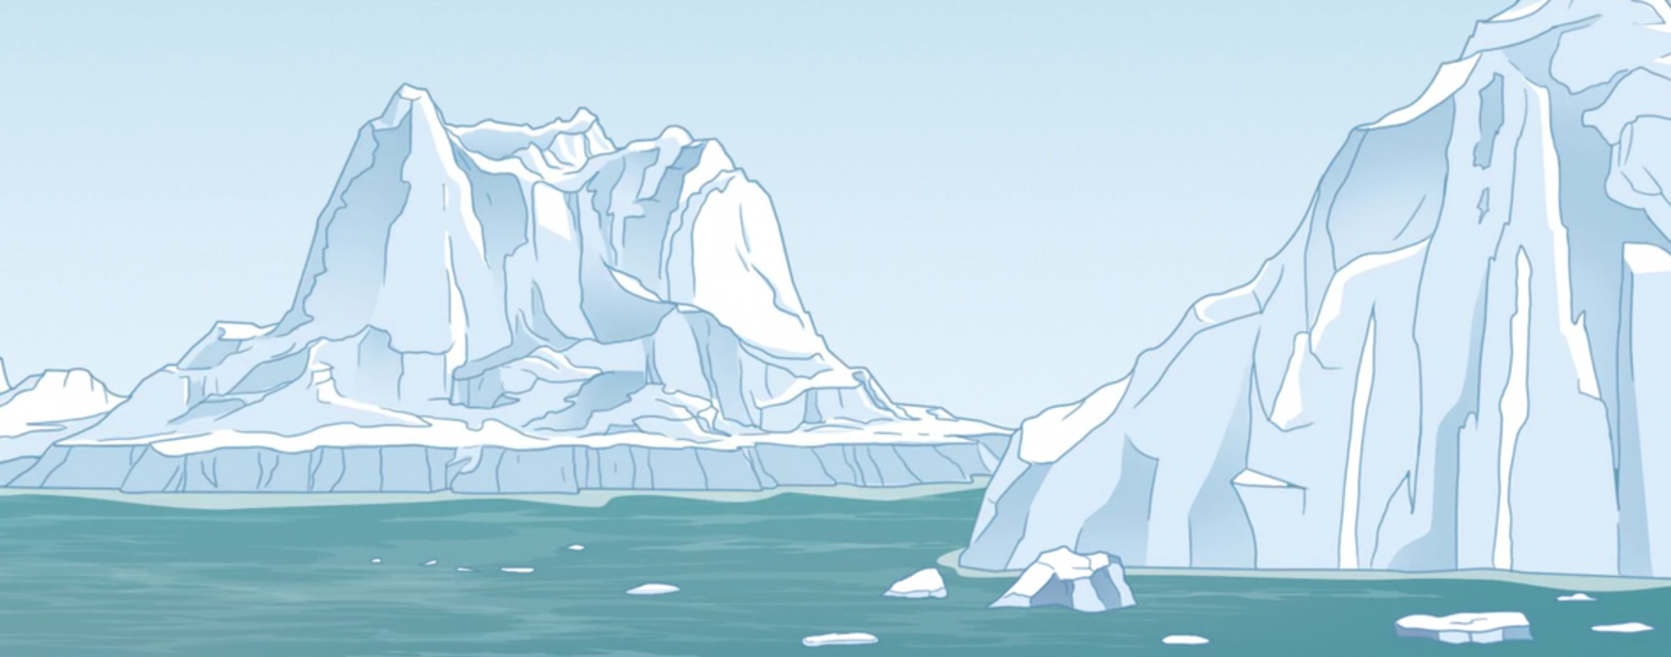
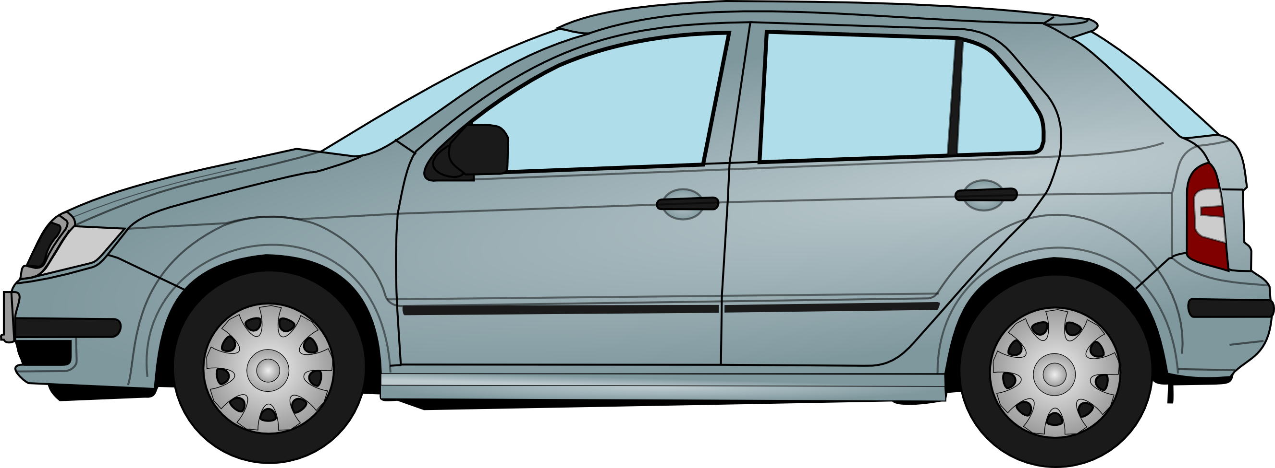
Which places to abate which threats?

Slide 7

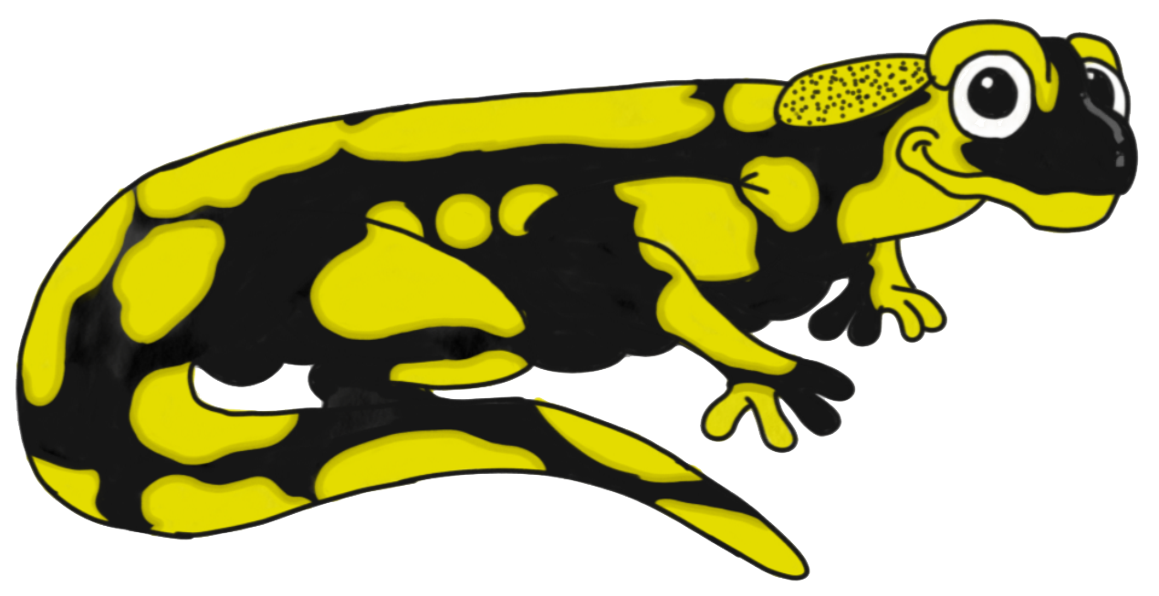
Find the cheapest set of actions needed to provide each species with adequate habitat
(assuming each place provides enough habitat for each species to persist)

Slide 8
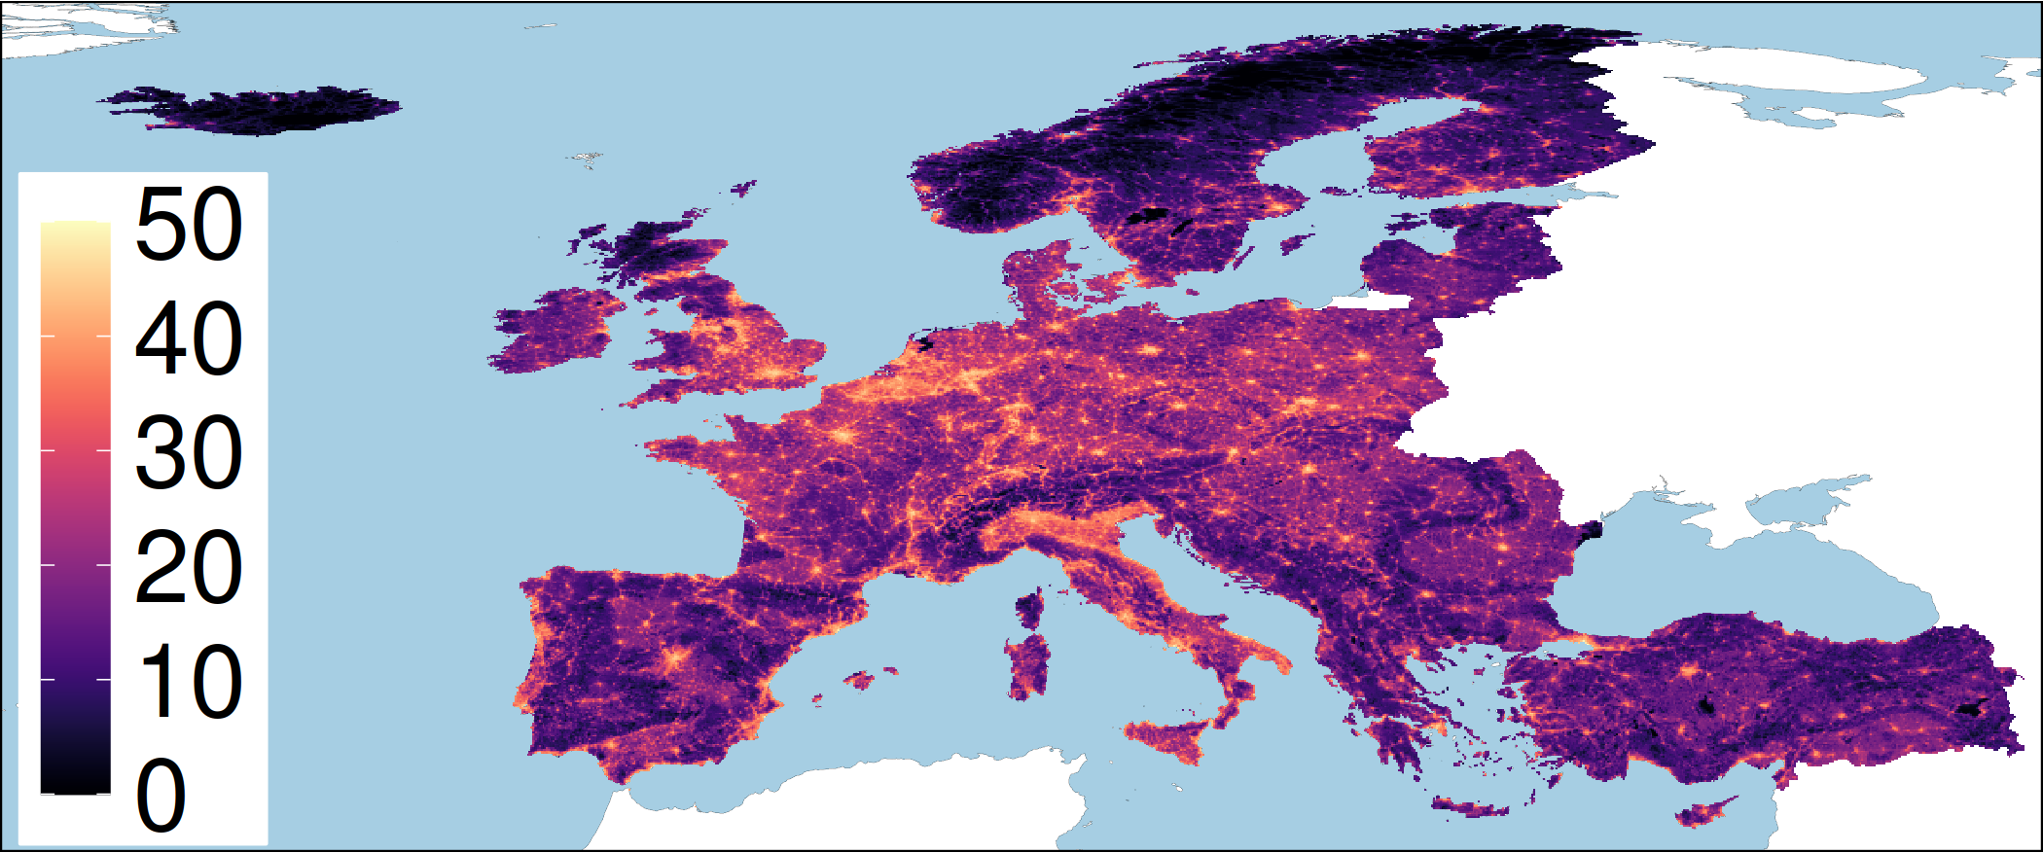
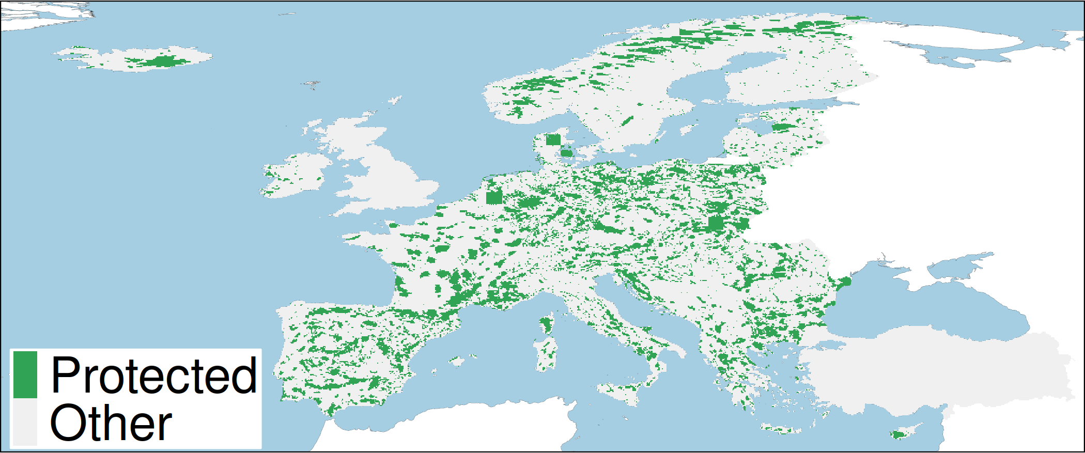
European case study
415 species: 81 amphibian, 135 birds, 79 mammal, 120 reptile species
165,000+ planning units (grid cells)
Natura 2000 network and nationally designed protected areas
Conservation benefit for a species = amount of threat-free habitat in conservation areas
Human pressure

Slide 9
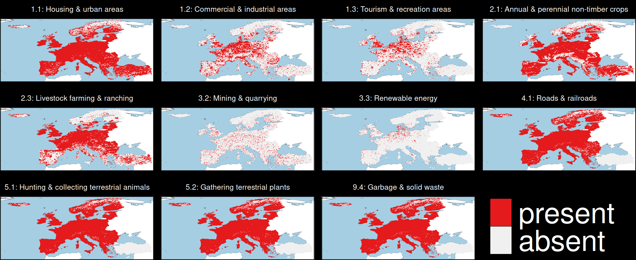
Threats to biodiversity

Slide 10
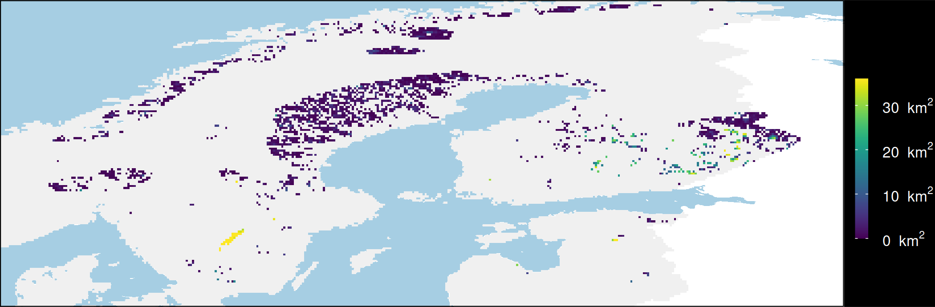

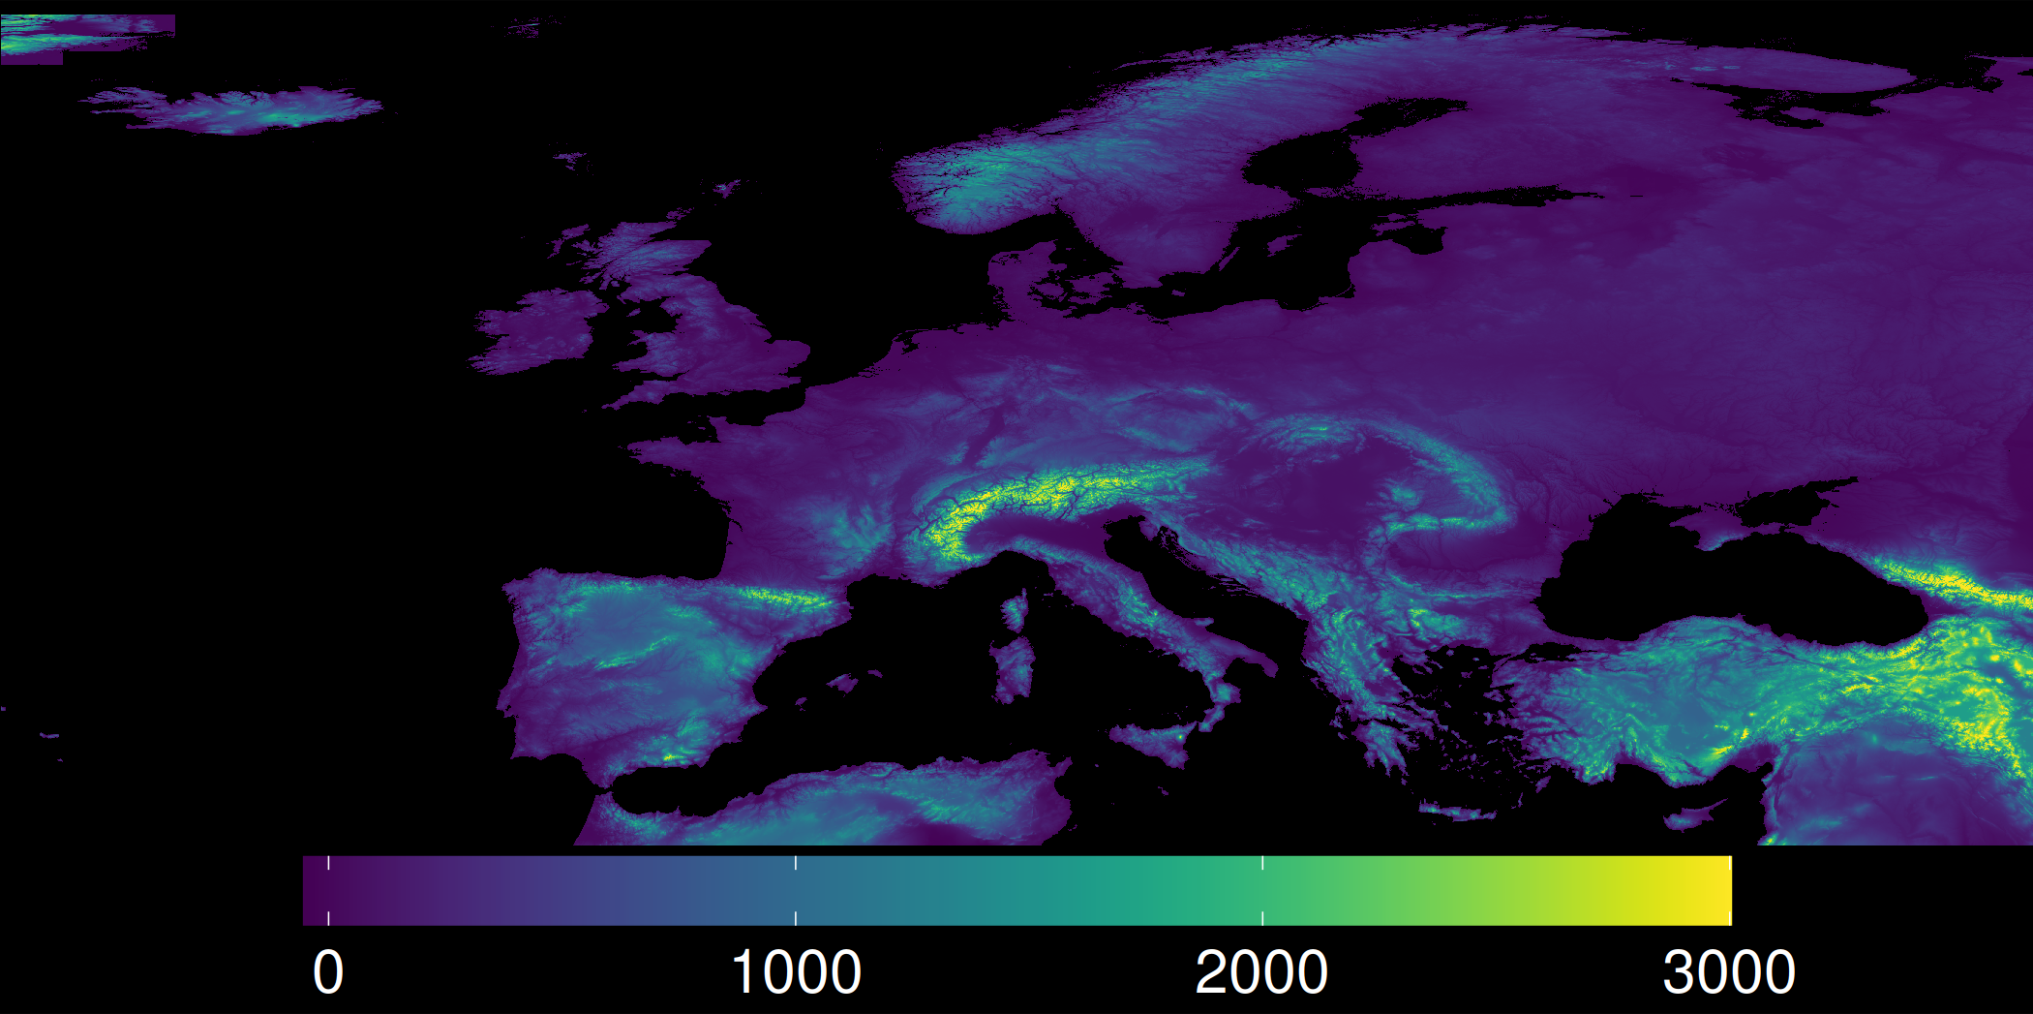
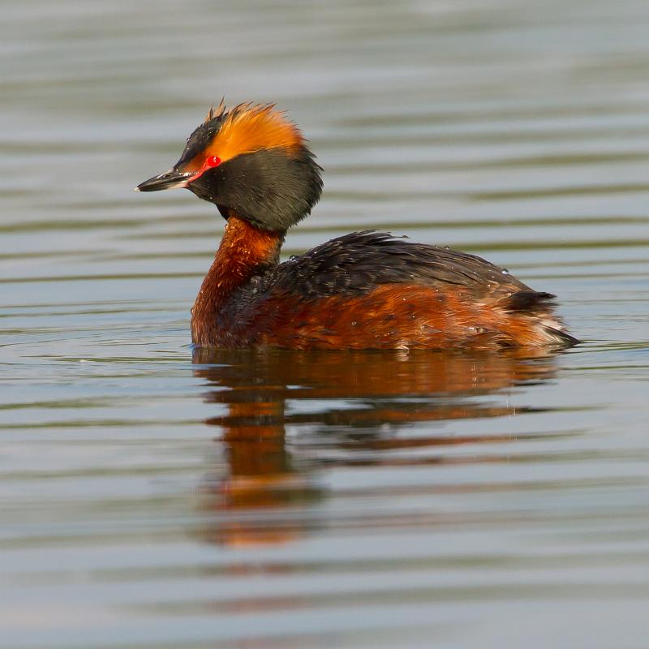
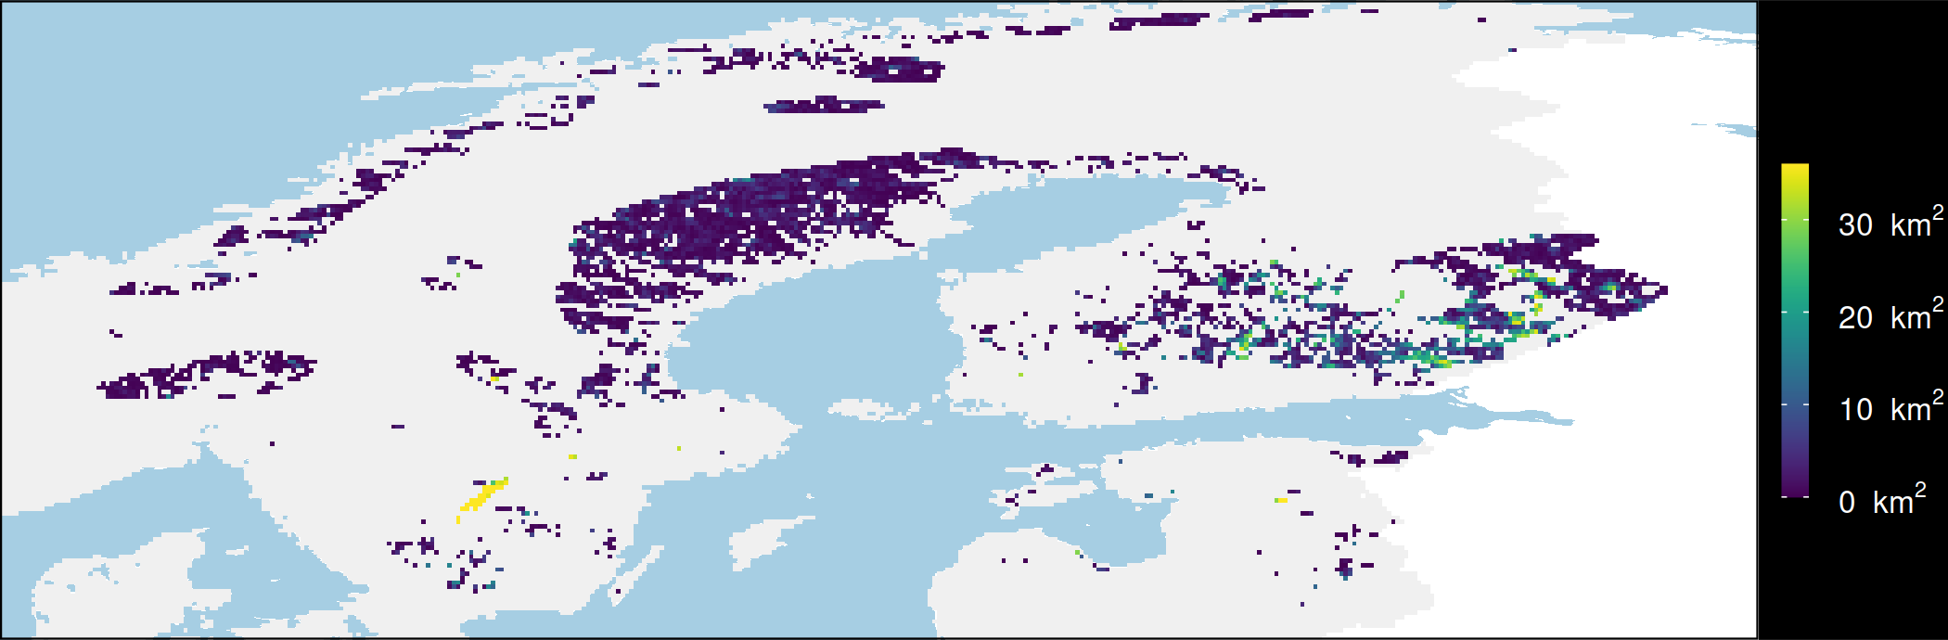
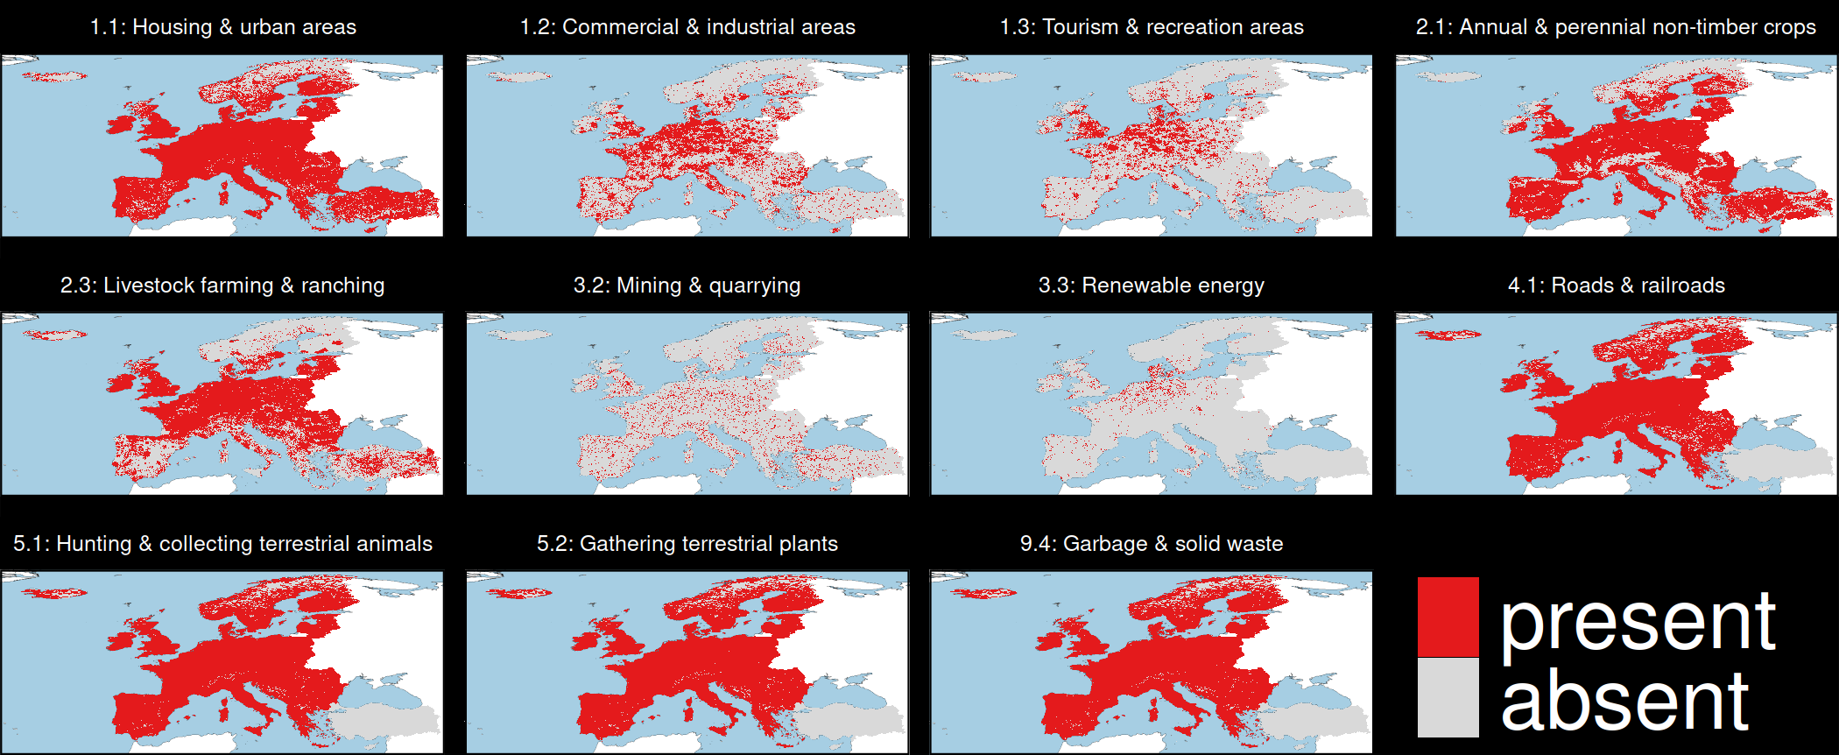
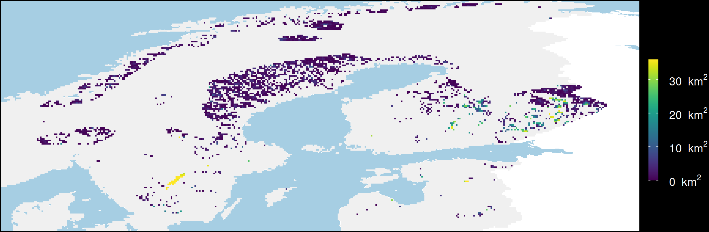
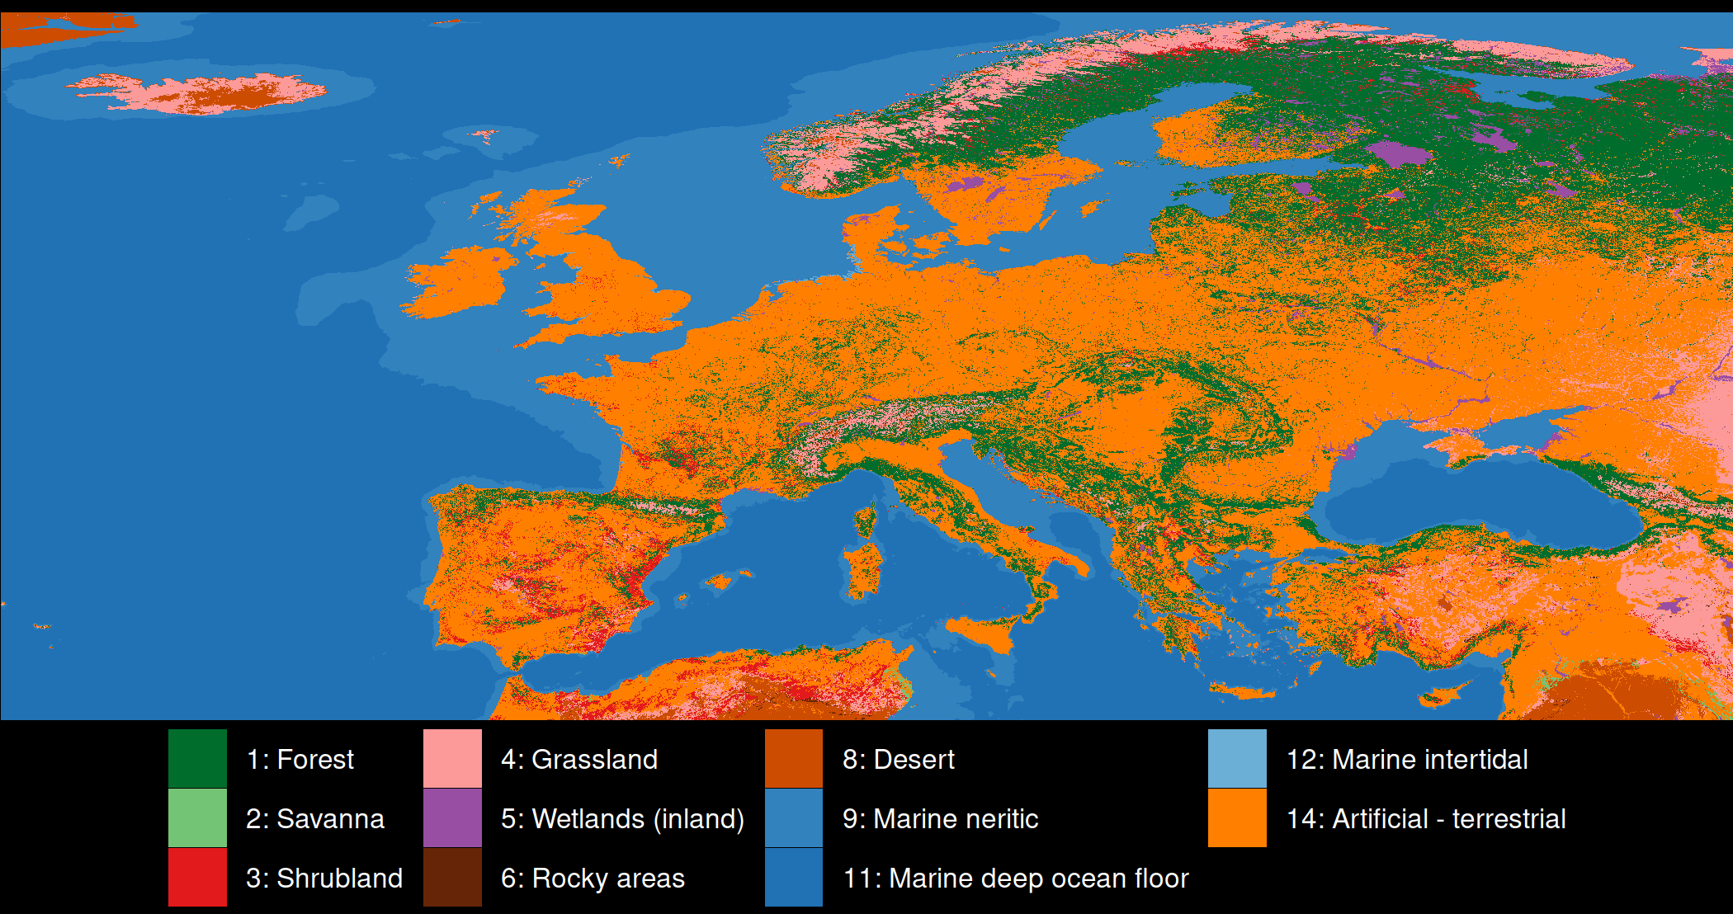
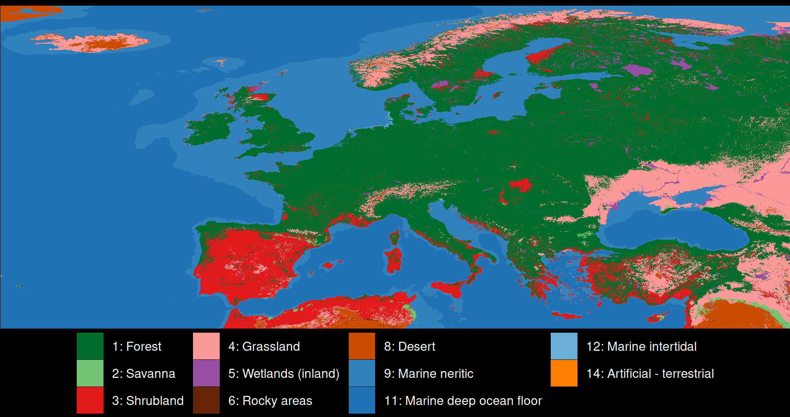
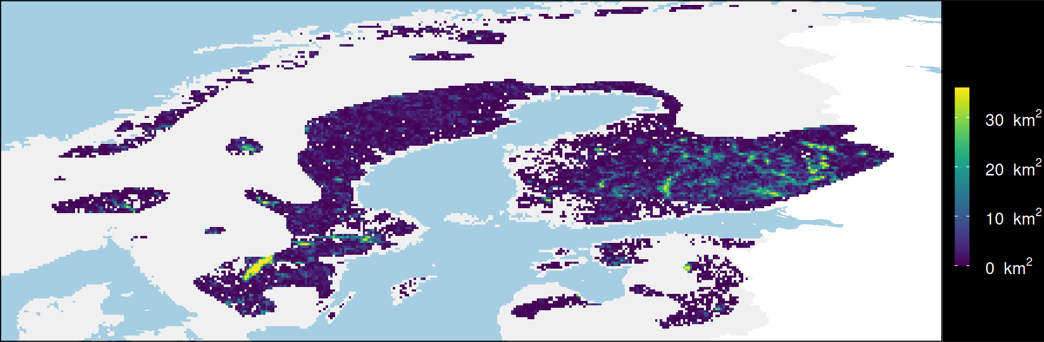
Mapping consequences
Protect existing habitat
Species
Elevation
Horned Grebe
Restore urban areas
Threats
What if?
Restore croplands
Current
land cover
Potential natural
vegetation
Restore urban & croplands

Slide 11
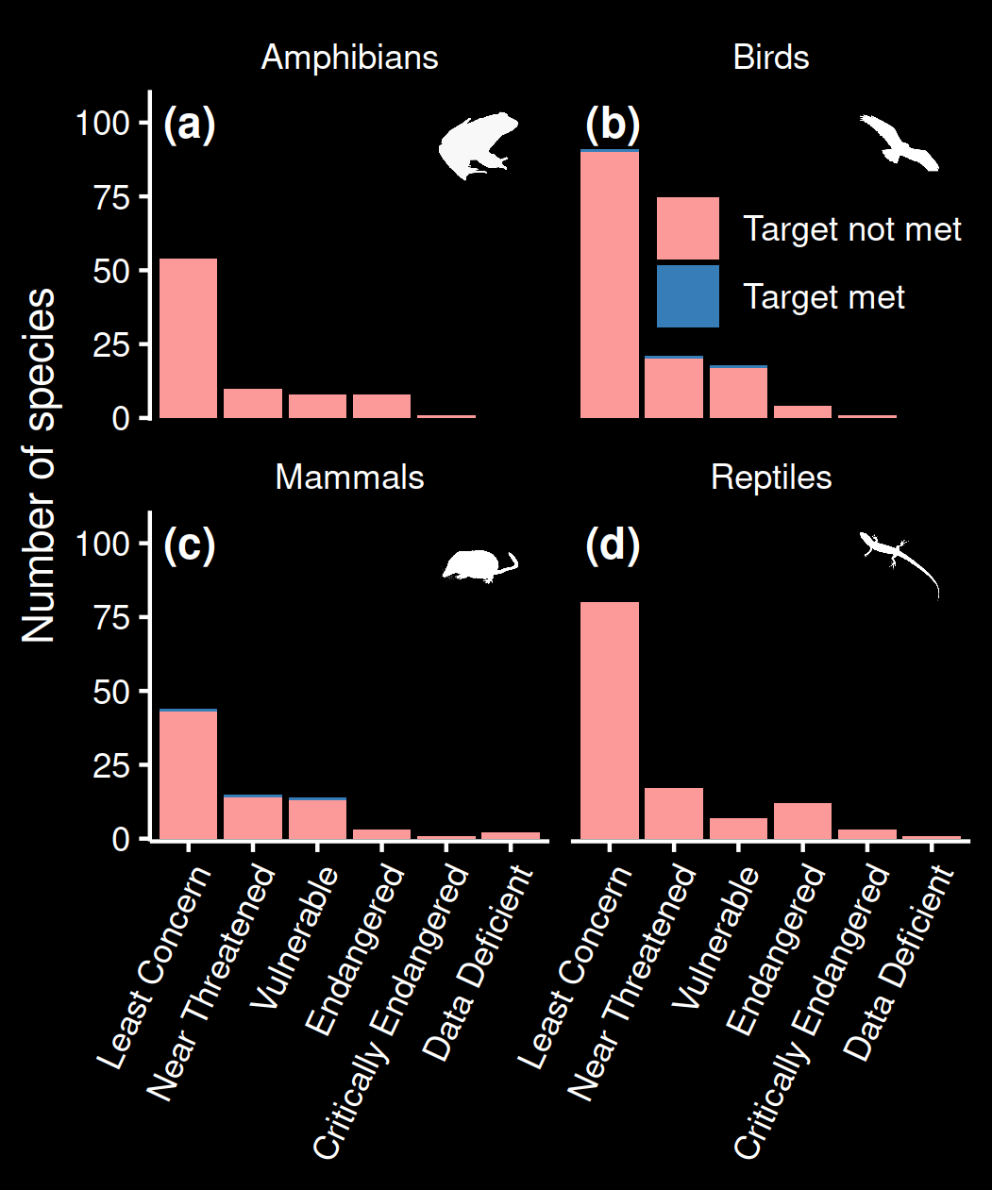
Performance of existing protected areas
Only 6 / 415 species with adequate threat-free habitat within protected areas
0 amphibians and reptiles!
Much worse than previous assessments which don’t account for threats

Slide 12
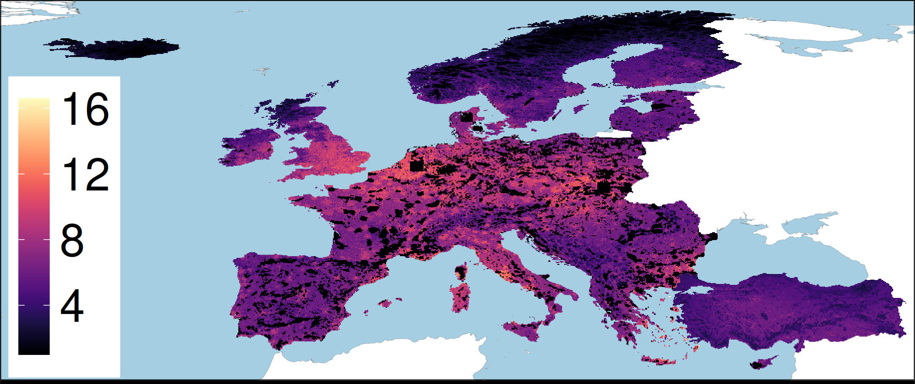
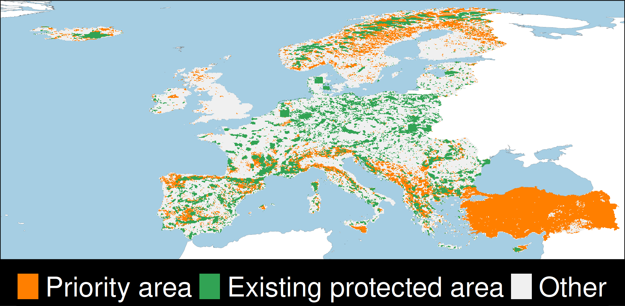

Priority areas for establishing protected areas
Existing threat-free
habitat for 415 species
Protected areas
Opportunity cost
Decision support tool,
powered by optimization
prioritizr

Slide 13
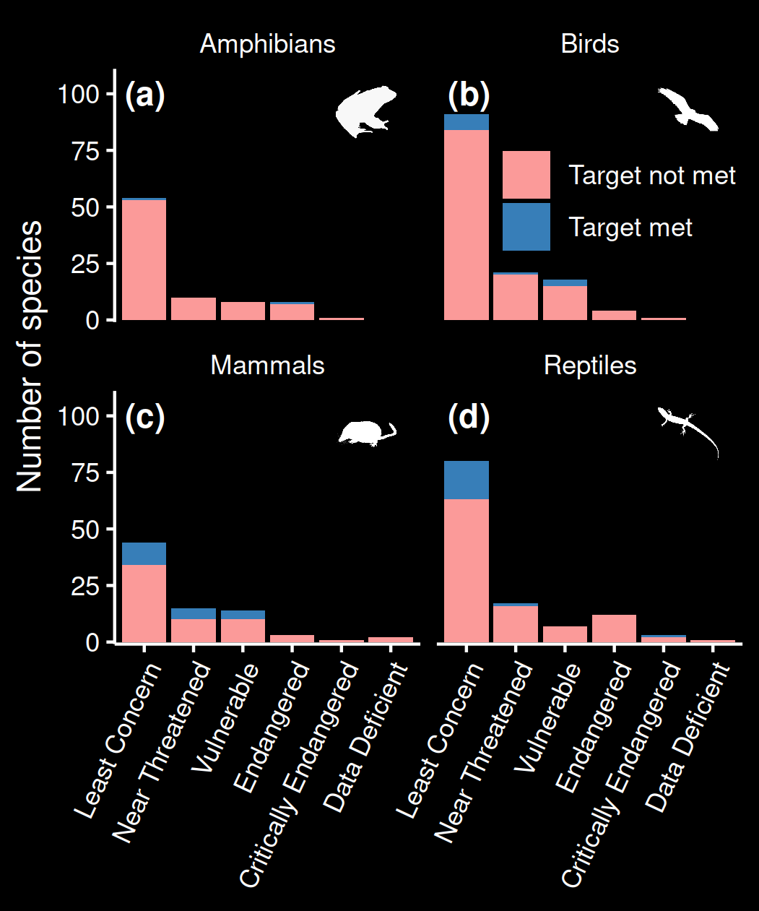
Establishing new protected areas
Improves to 51 / 415 species with adequate threat-free habitat within protected areas
Most species are Least Concern
Still only 2 amphibians

Slide 14
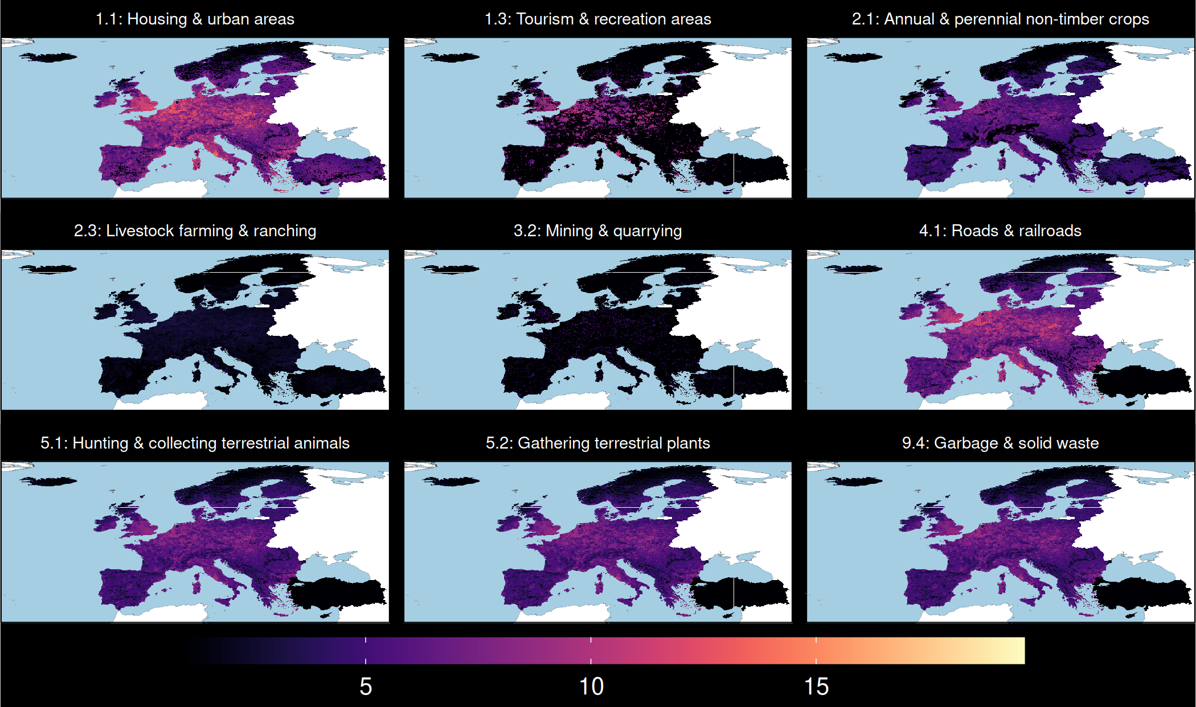
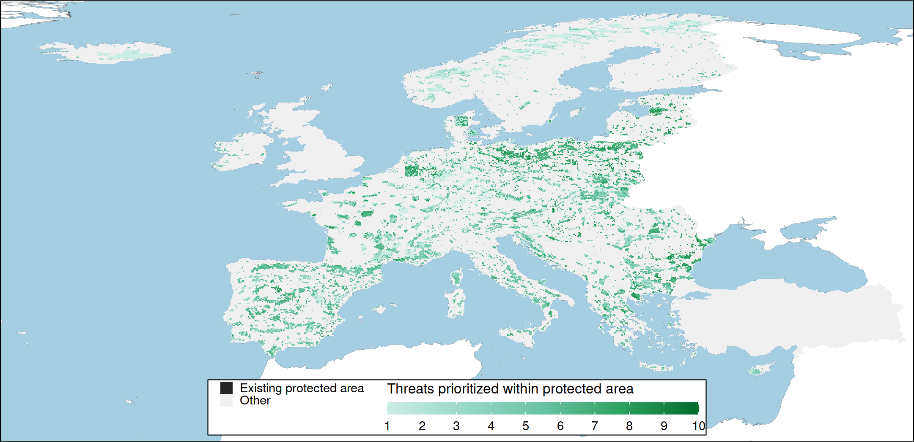
Prioritizing improvement of protected areas
Consequence maps for 415 species under 512 threat combinations
Opportunity costs for each threat
Protected areas
Decision support tool,
powered by optimization
prioritizr

Slide 15
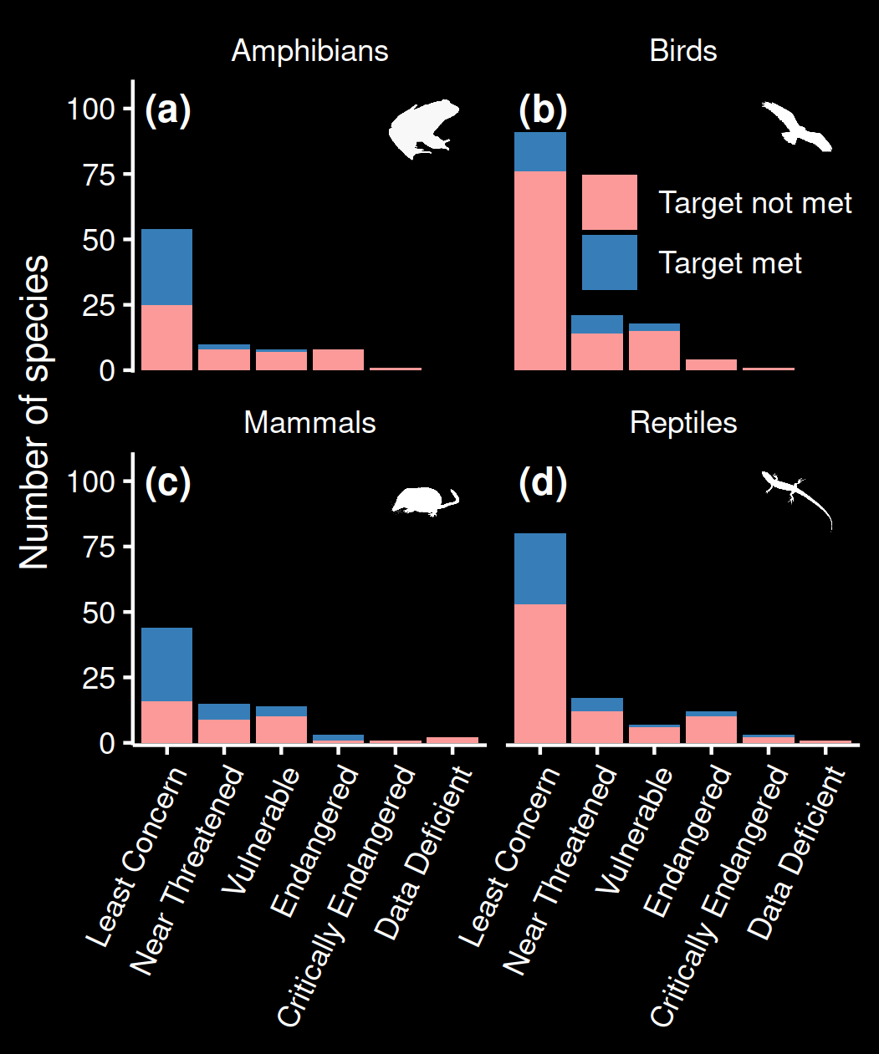
Improving existing protected areas
Bigger improvement to 133 / 415 species with adequate threat-free habitat within protected areas
39% amphibian, 19% bird 50% of mammal, and 30% of reptile species

Slide 16
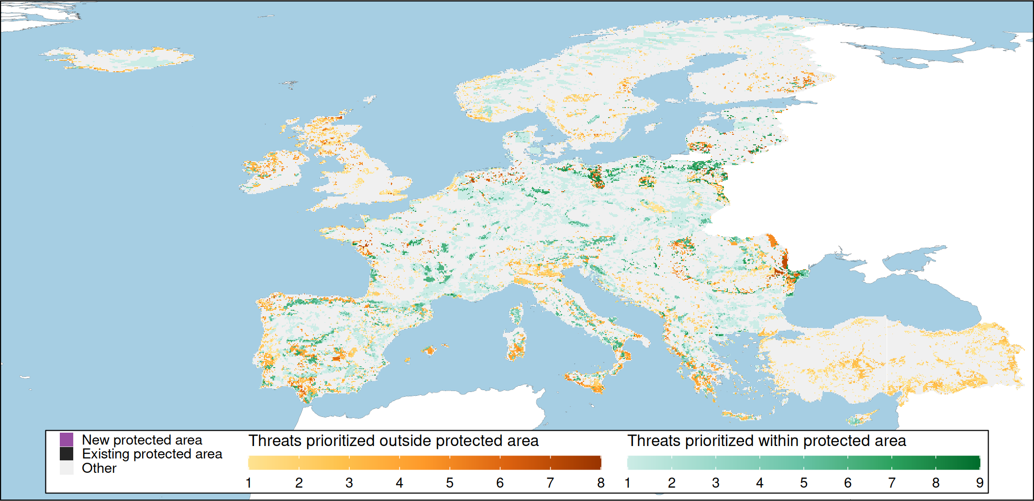
Prioritizing actions across Europe
prioritizr

Slide 17
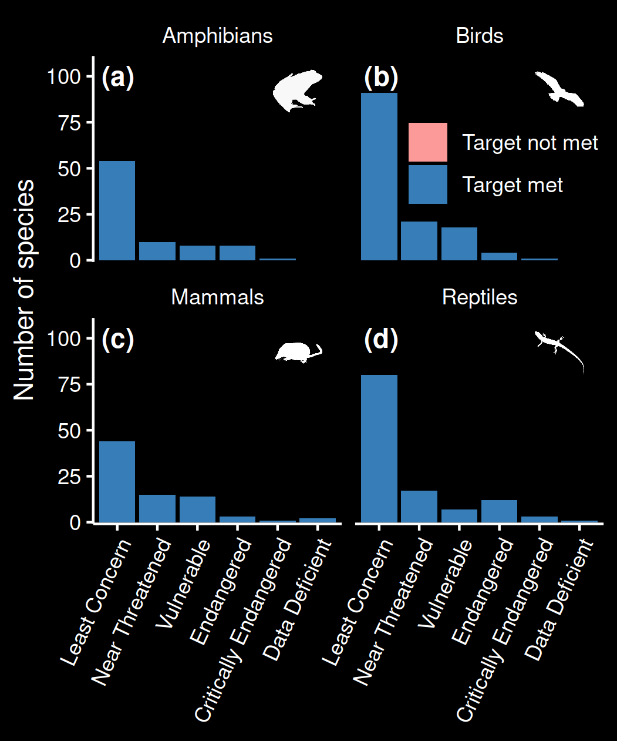
Prioritizing actions to abate threats
All species have adequate threat-free habitat within protected areas
Priority areas for abating threats span 17% of Europe

Slide 18
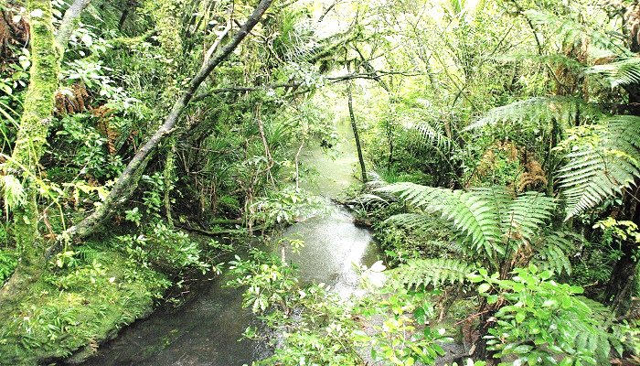
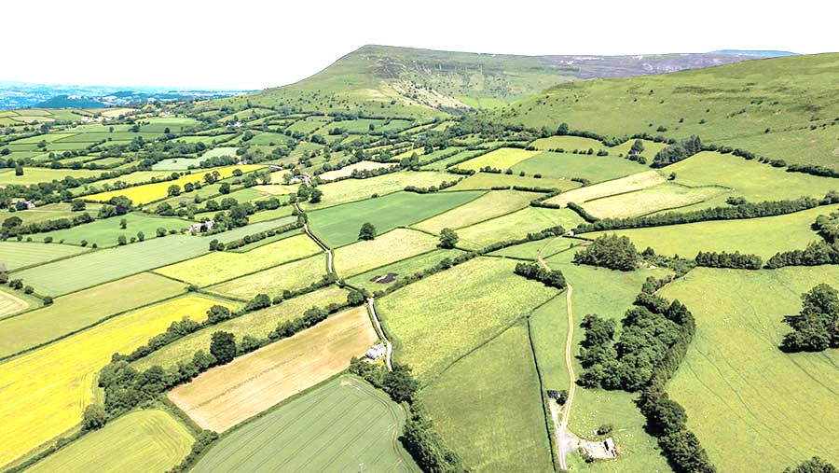
I’m a Kiwi – why should I give a shit?
What’s your vision for Predator Free 2050 and beyond? Do you just want rat-free farms and urban areas? If not, maybe worth thinking about the other threats too?
Now
Future

Slide 19
I’m a Kiwi – why should I give a shit?
NZ has limited funding for conservation. Maybe think about synergies between actions for invasive species management and other threats to achieve greater conservation outcomes?
$3M
$5M
$6M

Slide 20
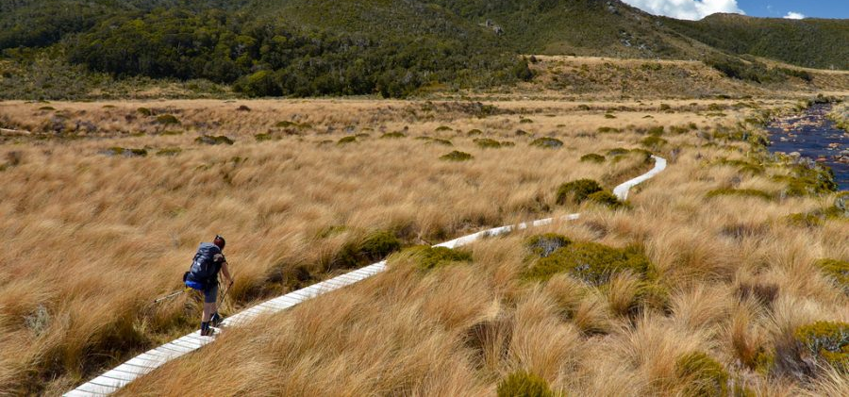
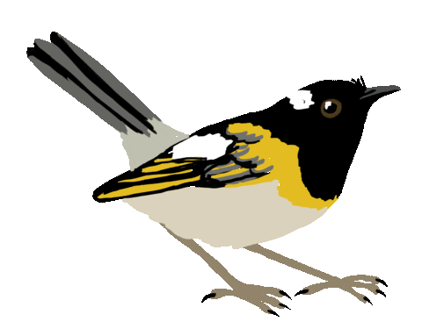
I’m a Kiwi – why should I give a shit?
NZ species aren’t all hyper-generalists. Maybe think about the consequences of managing invasive species in different places and how this might help different species? In other words, killing rats in grassland won’t help forest species.

Slide 21
Take home messages
Most EU species don’t have adequate habitat in protected areas that is free from threats
Improving management of existing protected areas is insufficient for many species
Strategically managing threats both within and beyond existing protected areas is needed
What you do and where you go matters!

Slide 22




jeffrey.hanson@uqconnect.edu.au
github.com/jeffreyhanson
jeffrey-hanson.com

Slide 23
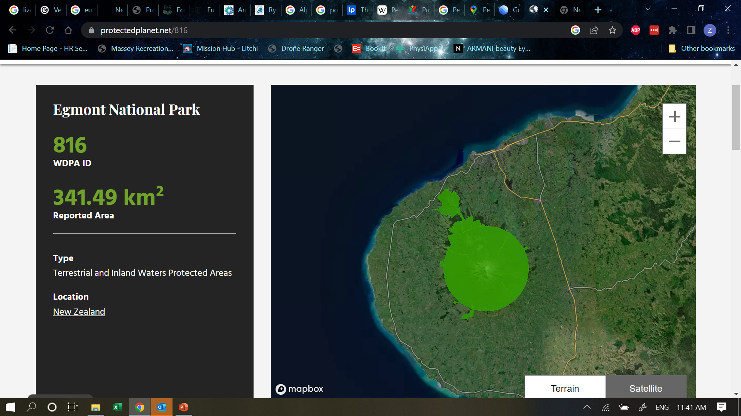
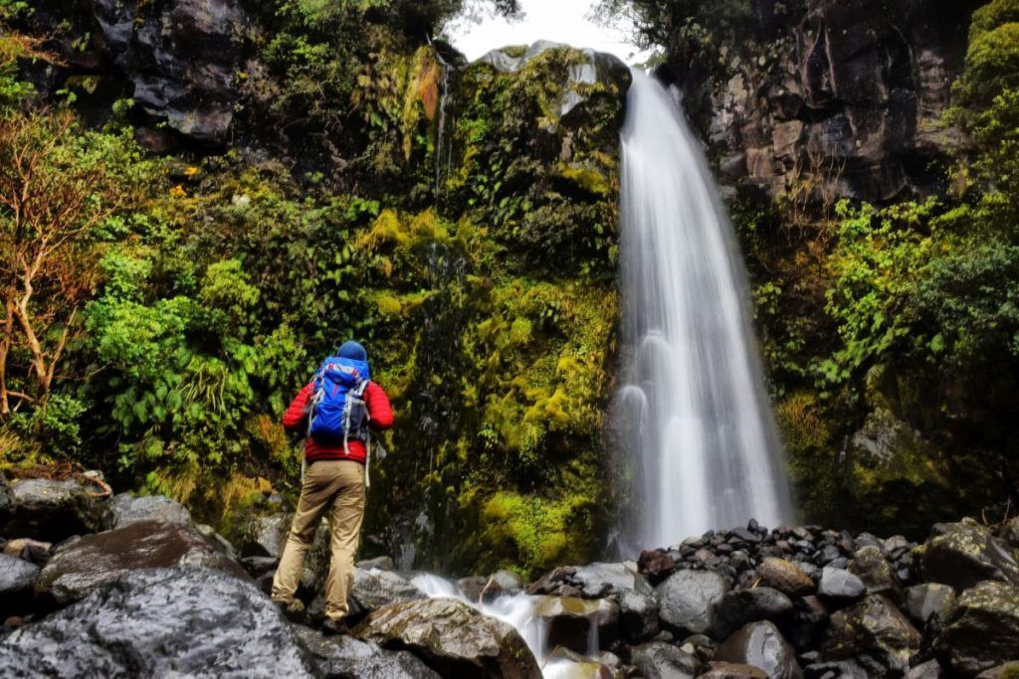
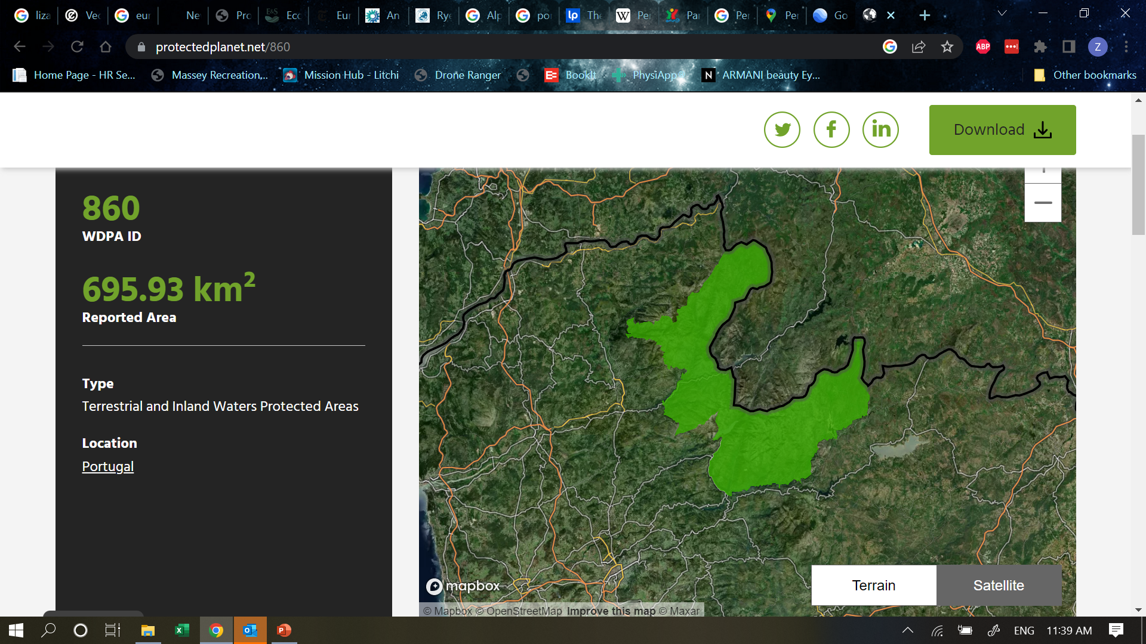
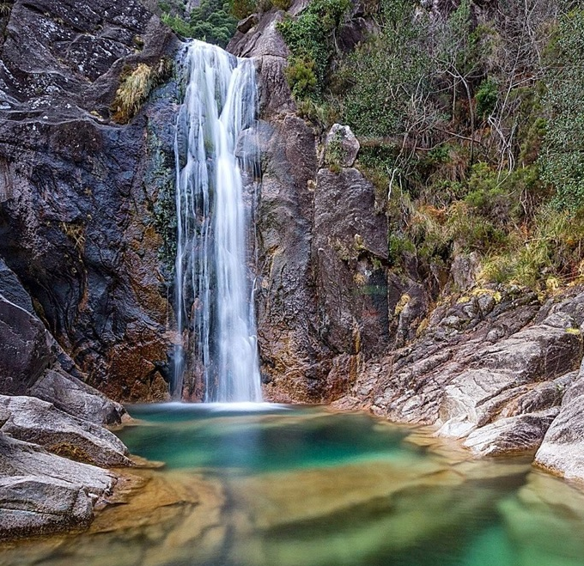
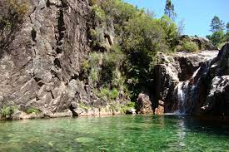
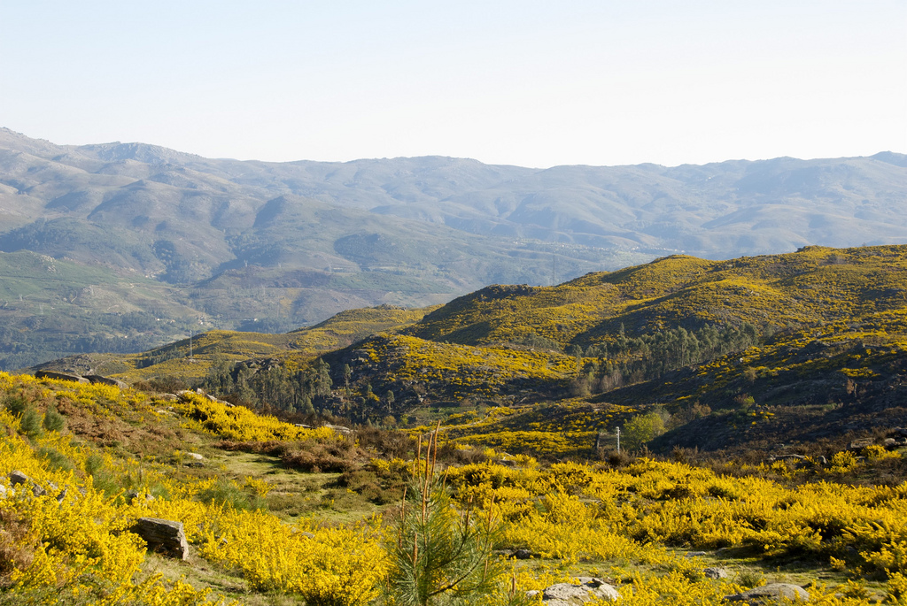
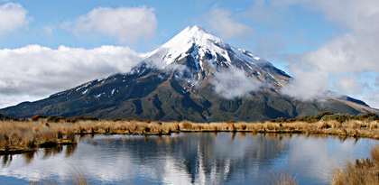
What’s in a protected area?
Taranaki National Park, NZ
Peneda-Gerês, Portugal

Slide 24
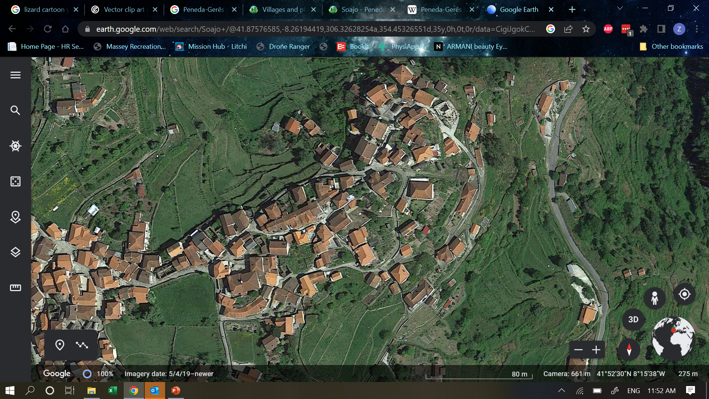
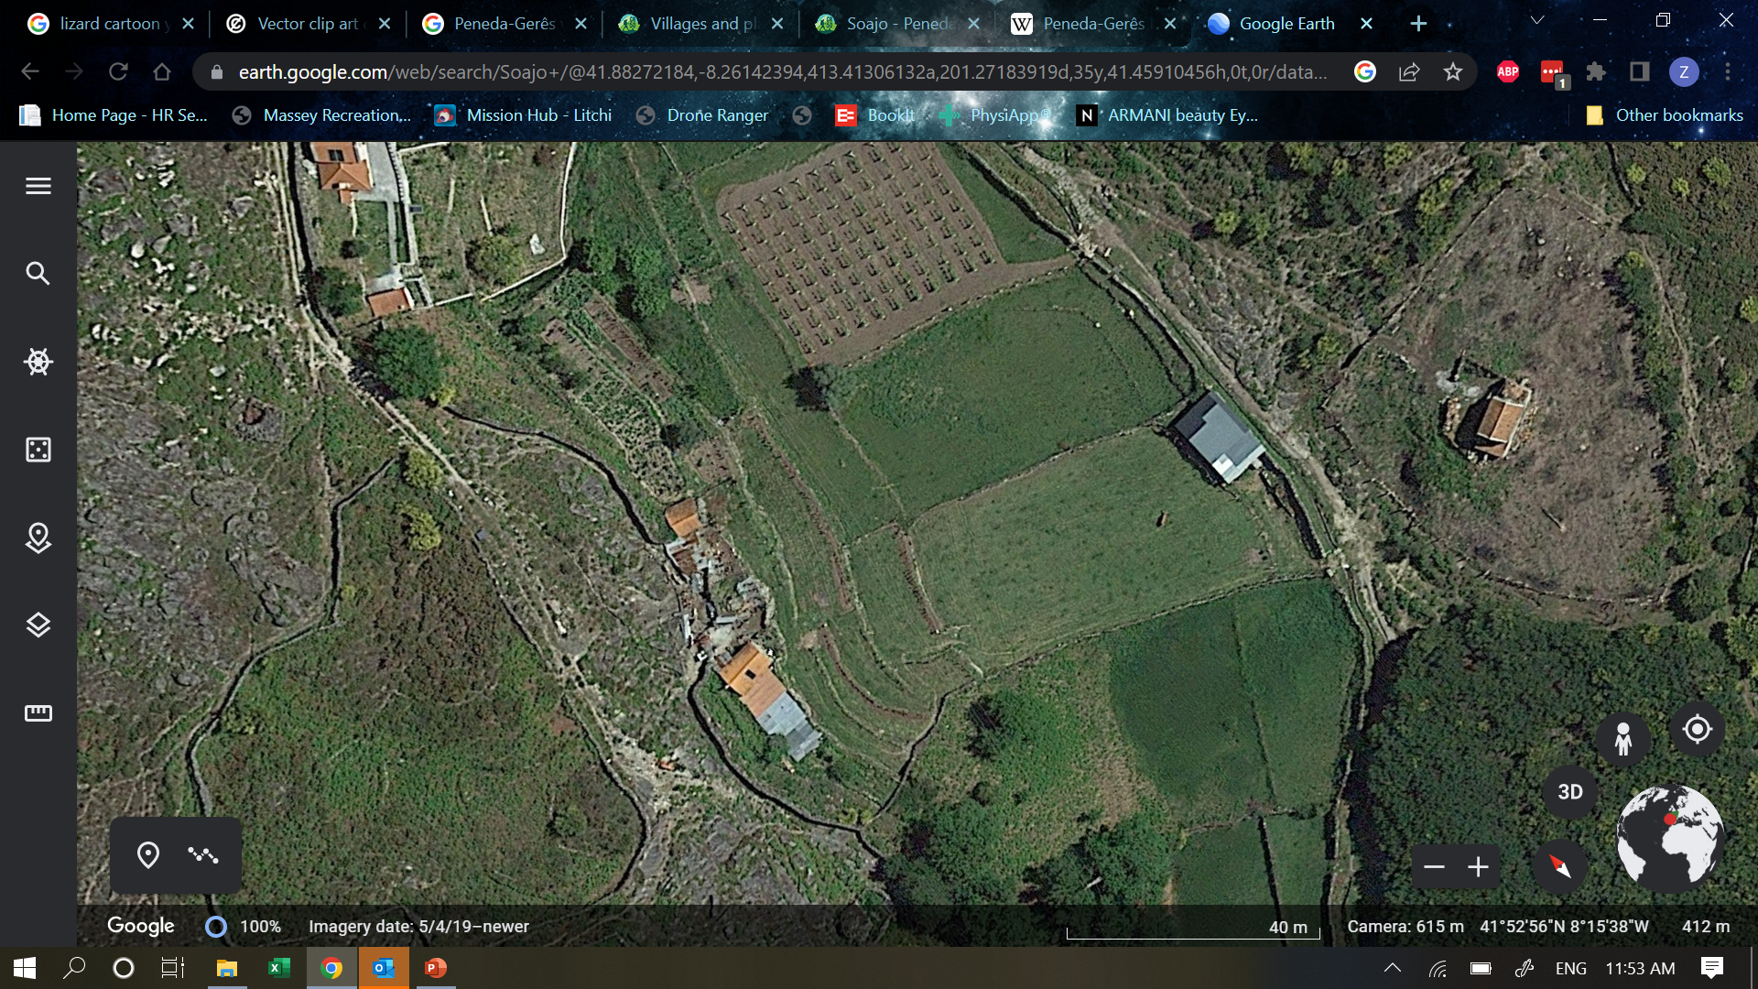
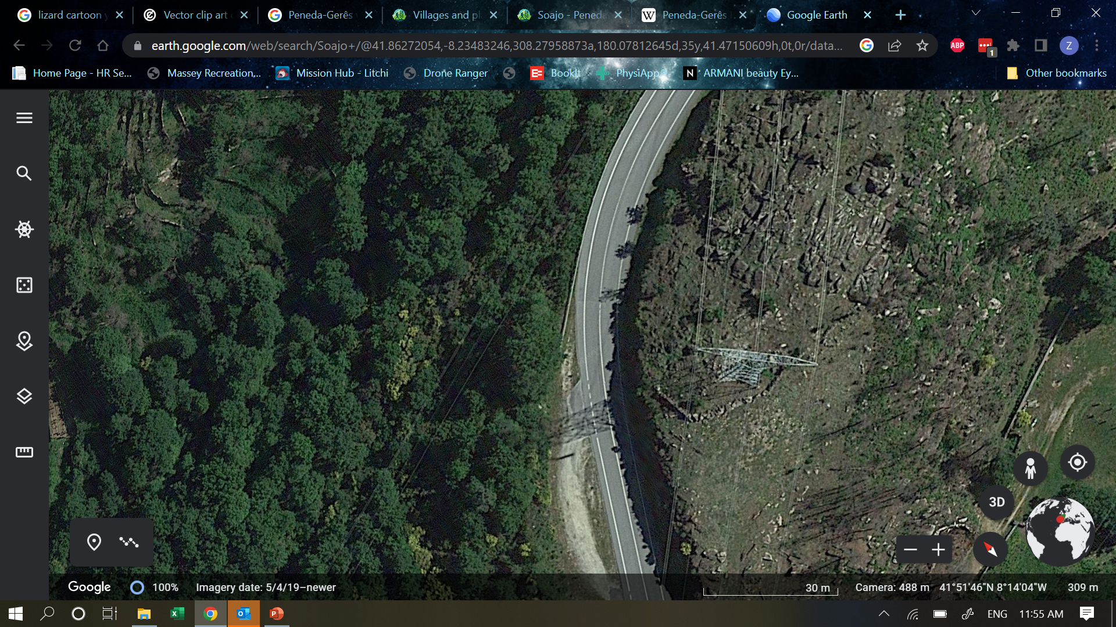
Land sparing vs. land sharing
Taranaki National Park, NZ
Peneda-Gerês, Portugal
Urbanization
Highways
Agriculture

Slide 25
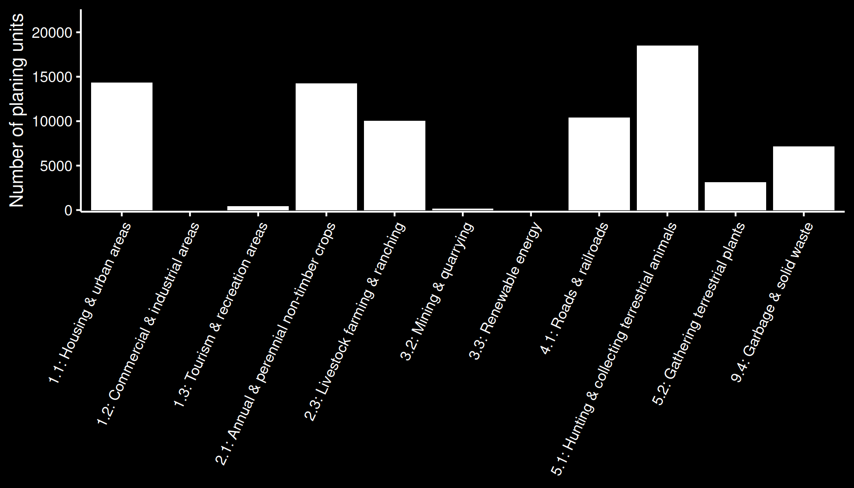
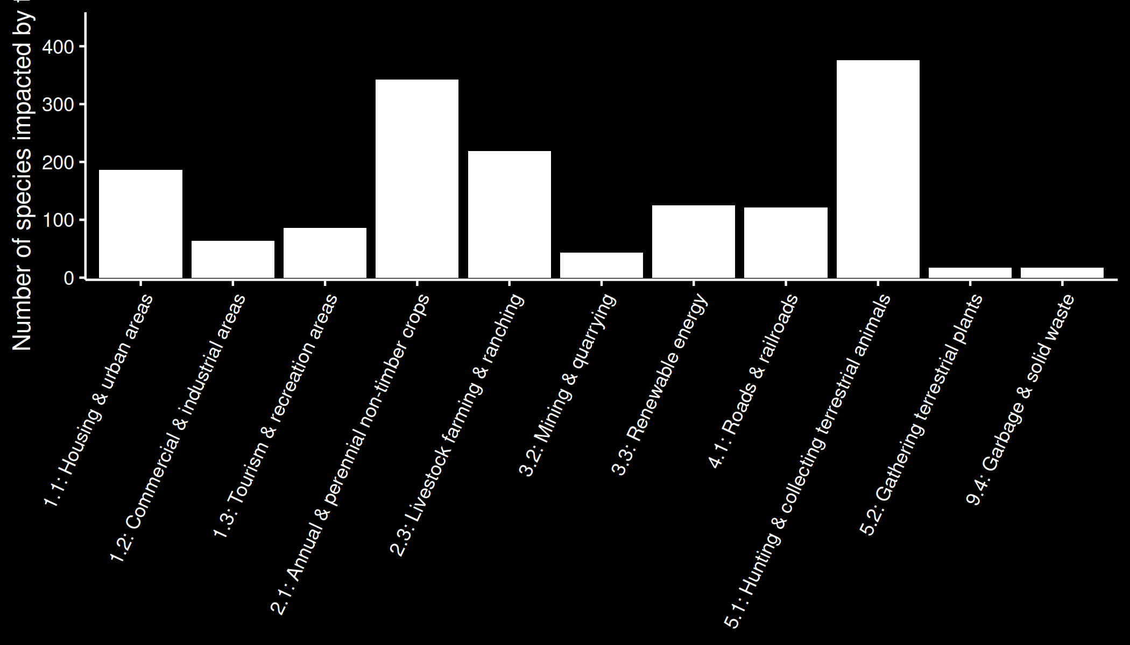
It’s not just as simple as focussing on threats that impact the most species
Number of planning units
Number of
species impacted

Slide 26
Mapping suitable habitat for species
Current land cover
Elevation
Threats
Species
habitat types
elevational limits
threat impacts
Horned Grebe
Area of threat-free habitat

Slide 27
Which places to abate which threats?

Slide 28
Which places to abate which threats?

